Slide 1
Bright Coffee Shop Analysis
Business insight for strategic growth
Pesented by: Gugulethu Dlamini

Slide 2
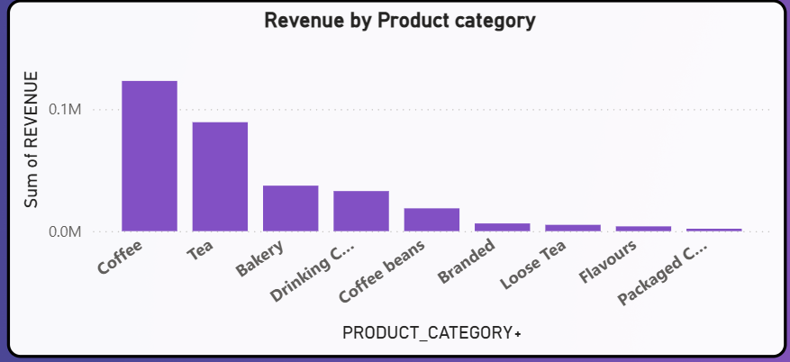
Revenue breakdown by product category
Coffee is the top revenue driver with a total of R123 083.45
The backery has a moderate contribution, there is potential if sold as a combo e.g + Coffee/Tea
Sugessting introducing Promotions for increased sales.

Slide 3
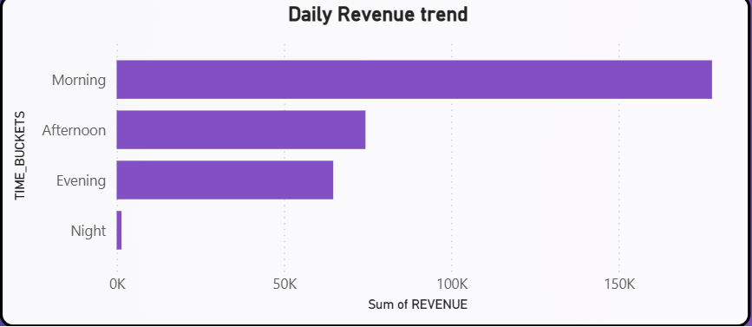
Sales by time of the day
Morning hours (06:00–11:59) consistently generate the highest revenue, followed by Afternoon. Sales drop significantly after 8 PM, indicating an opportunity for evening campaigns or loyalty programs

Slide 4
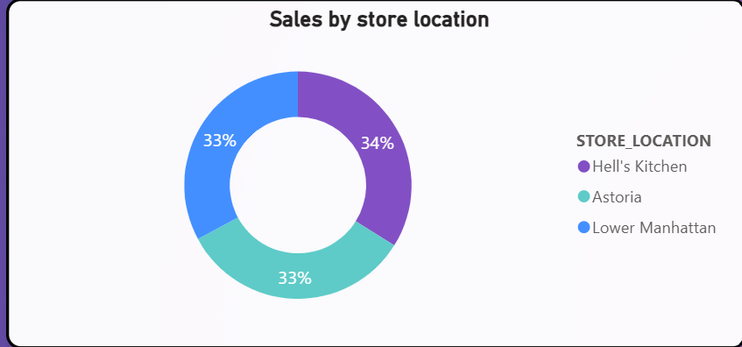
Analysis on Store Location
One store consistently outperforms the others in total revenue, likely due to higher foot traffic or better product mix.
The second location shows moderate performance, with steady weekday sales but lower weekend spikes.
The third location underperforms, suggesting issues with customer volume, product appeal, or operational efficiency.

Slide 5
Strategic Recommendations
Boost marketing in underperforming locations during peak hours of other stores.
Consider menu localization—tailoring offerings to match customer preferences by location.
Use cross-location comparisons to identify best practices and replicate success.

Slide 6
Thank you.

